Slide 1

VITA App
Training for Site Coordinators

Slide 2
Why an App?
Improve client experience
Reduced wait times
Provide feedback
Improve volunteer experience
Go where they are most needed
Provide suggestions
How:
Focus volunteers on sites that need and can use help
Client: Visibility to sites and support options (MFT, Express, etc.)
Site Coordinators are key: they maintain the site calendar, site features, and site eFiler requirements

Slide 3
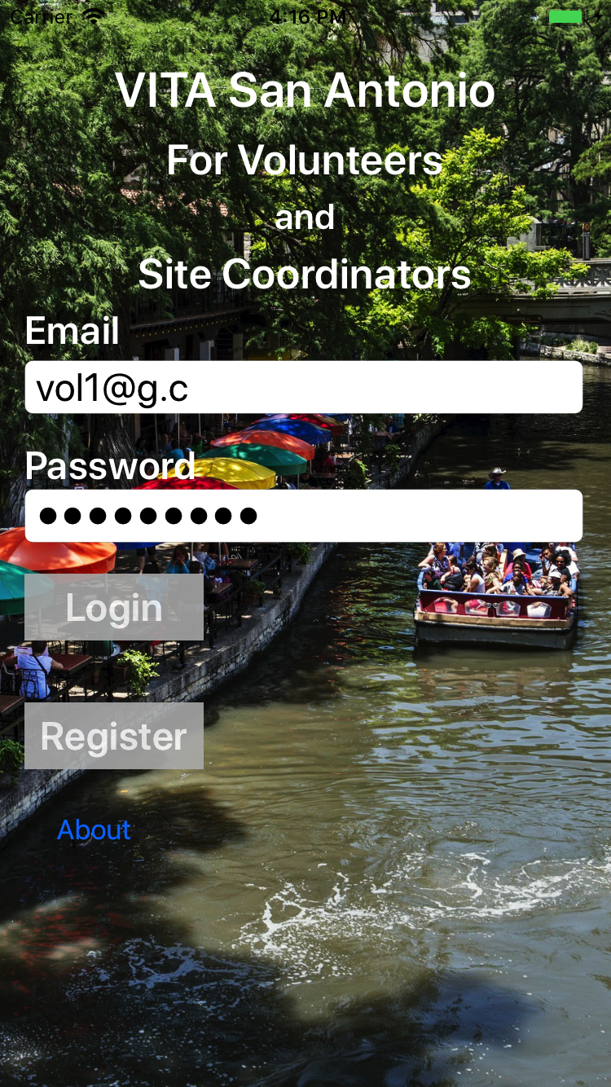
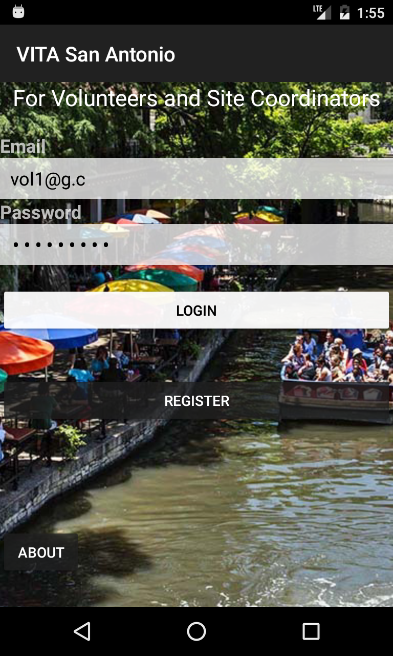
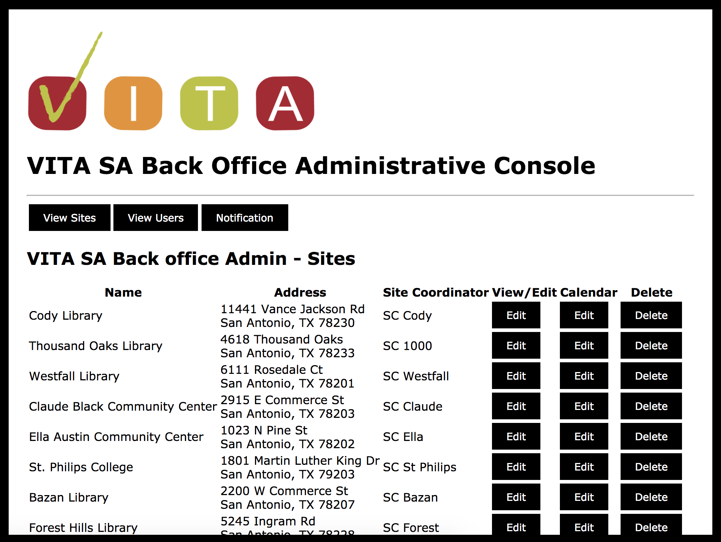
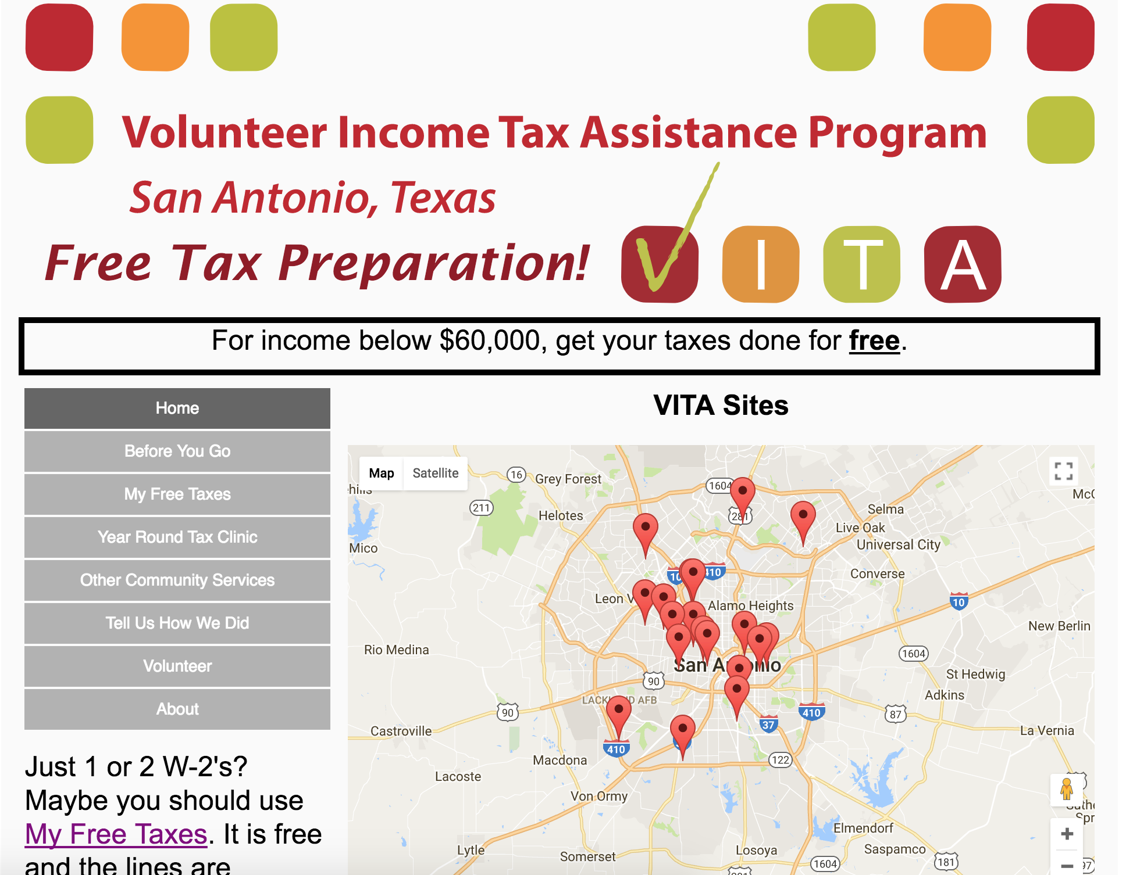
VITA App and Website
BackEnd
DB
iOS Devices
Android Devices
vitasa.org
(English and Spanish)
Back office administration
Client web and mobile

Slide 4
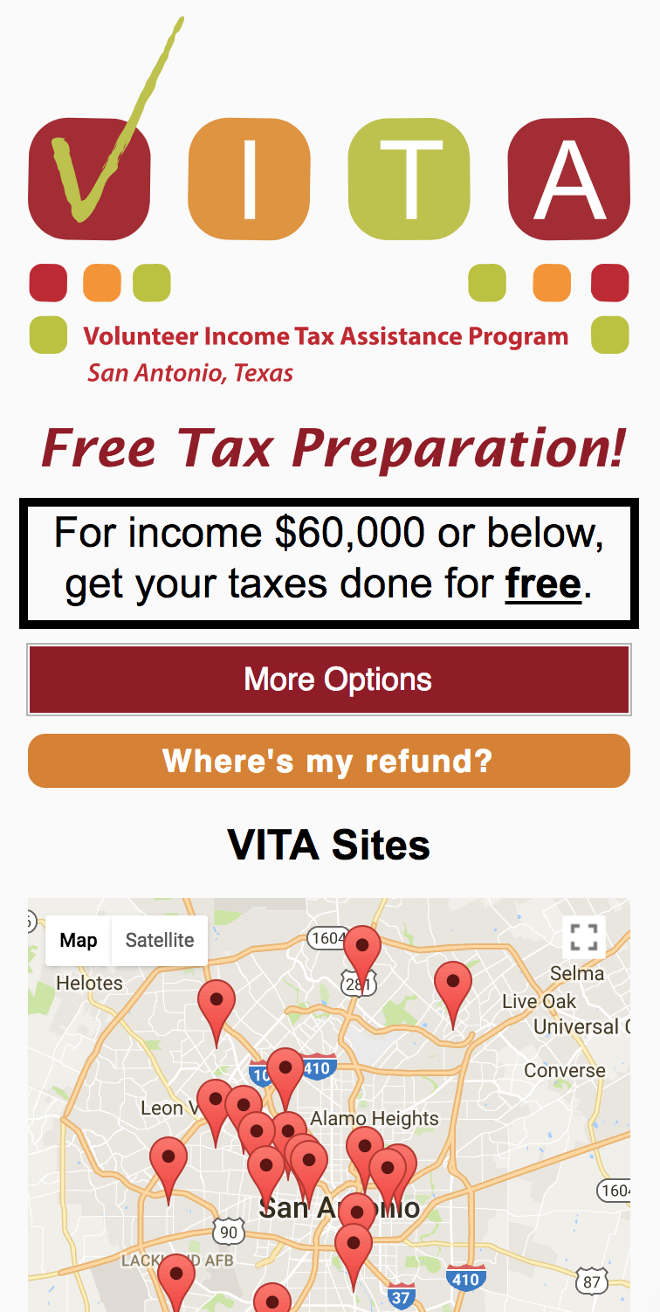
vitasa.org - Clients
Try it out: vitasa.org/en
Complete overhaul of vitasa.org
Home page: map of sites and guidance on what to bring
Info on VITA
List of VITA sites, address, and services
My Free Taxes: map and instructions
Year Around Tax Clinic: locations and services
Community services: list and services
Client feedback form
Contact Us: Alejandra and Sheila
Volunteers: why and how to volunteer
(Spanish and English)

Slide 5
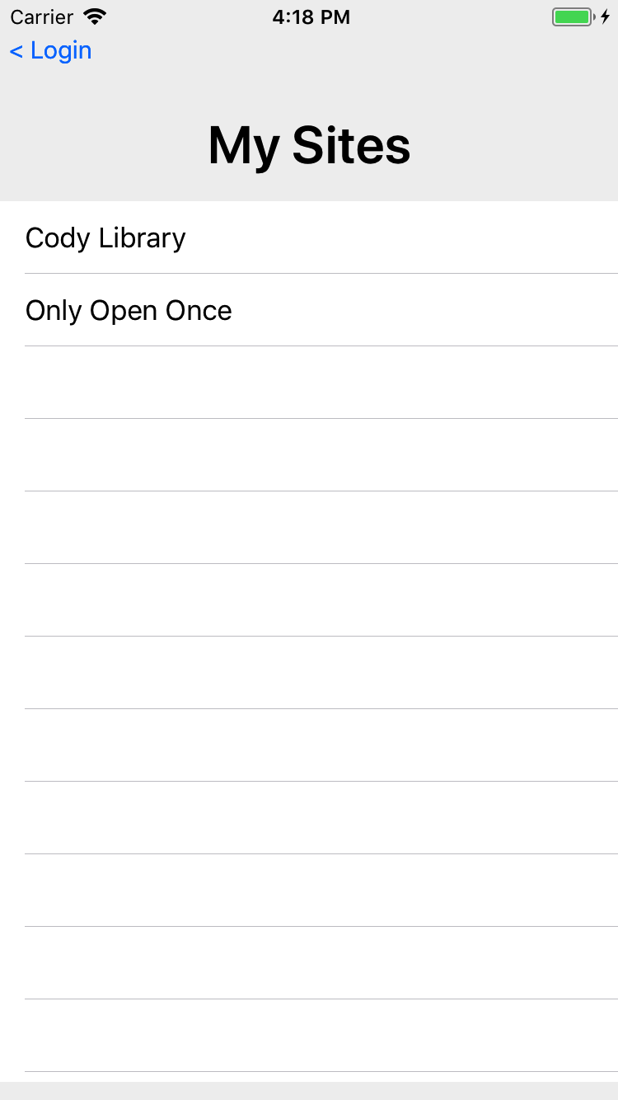
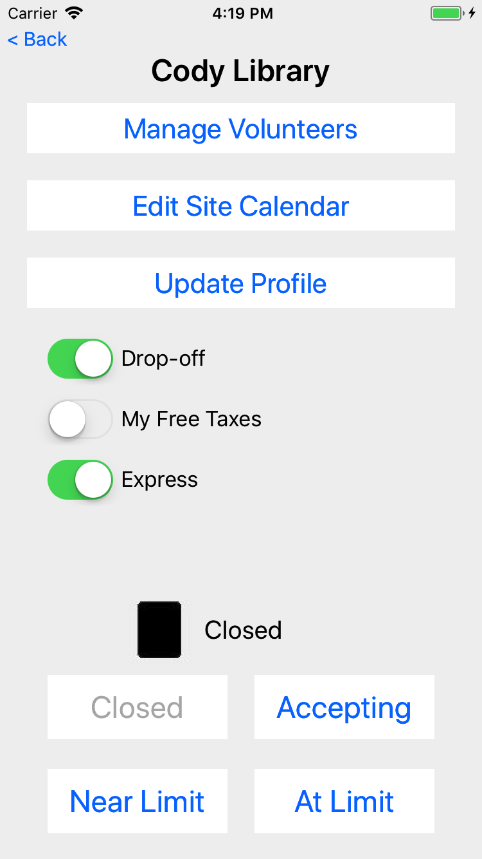
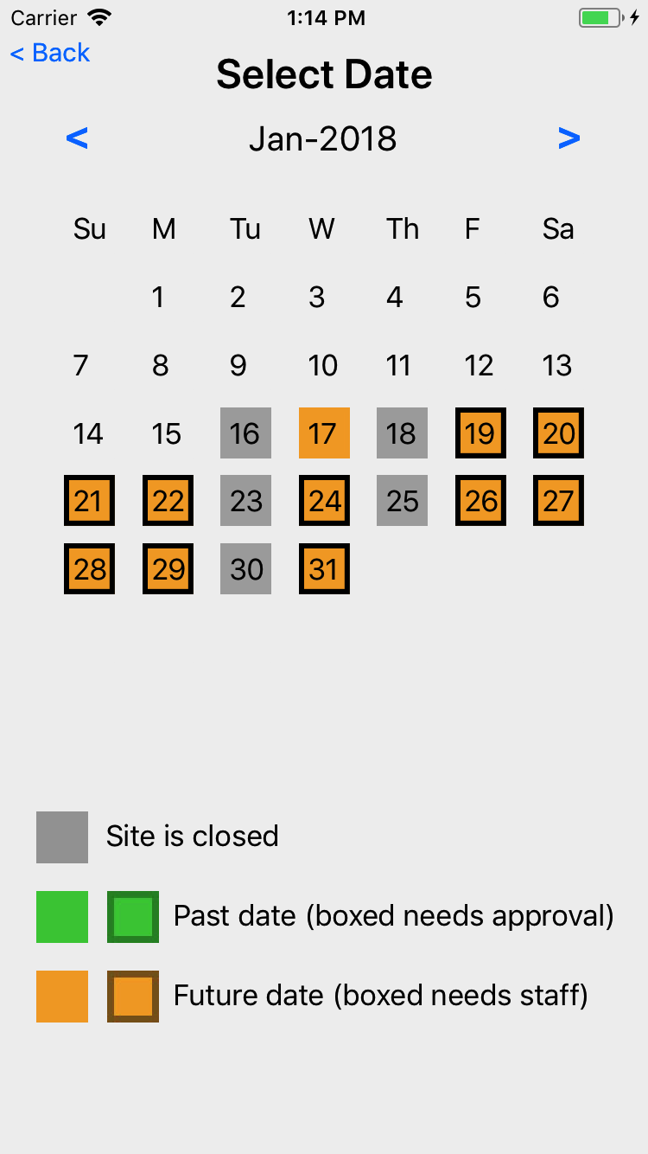
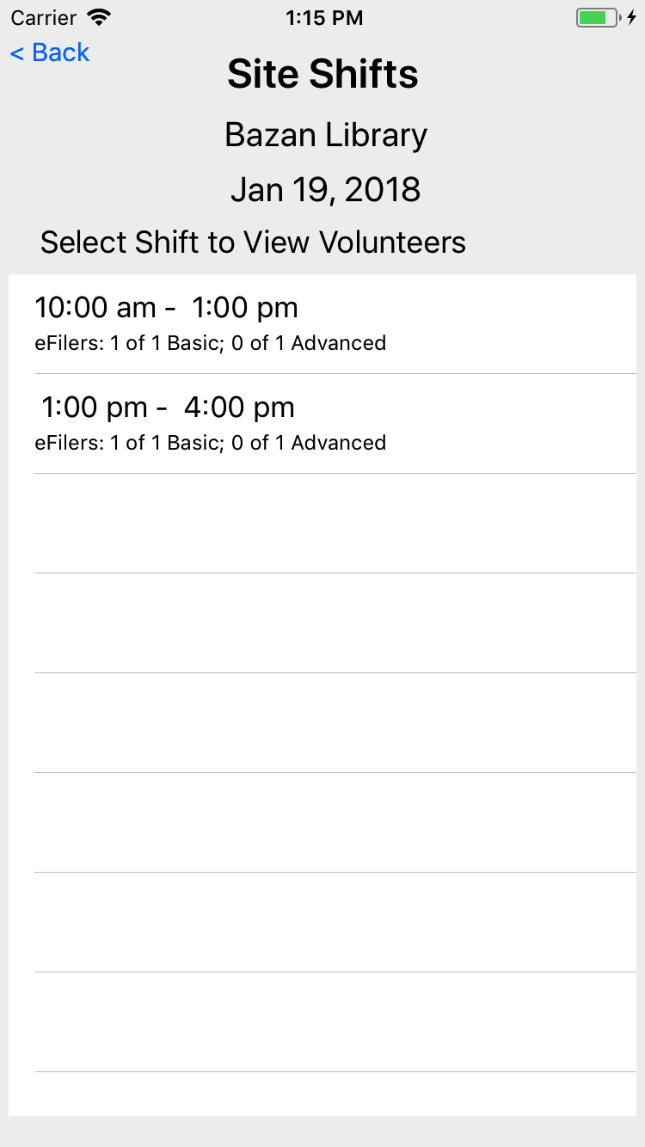
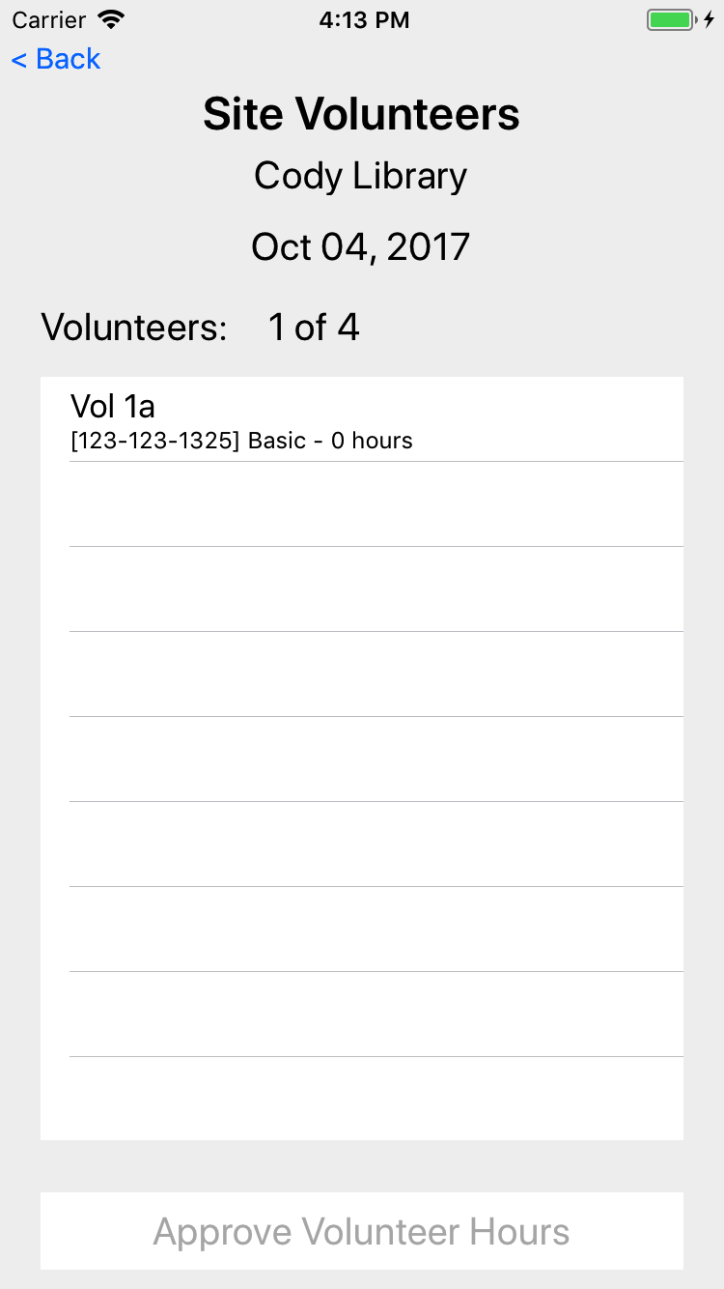
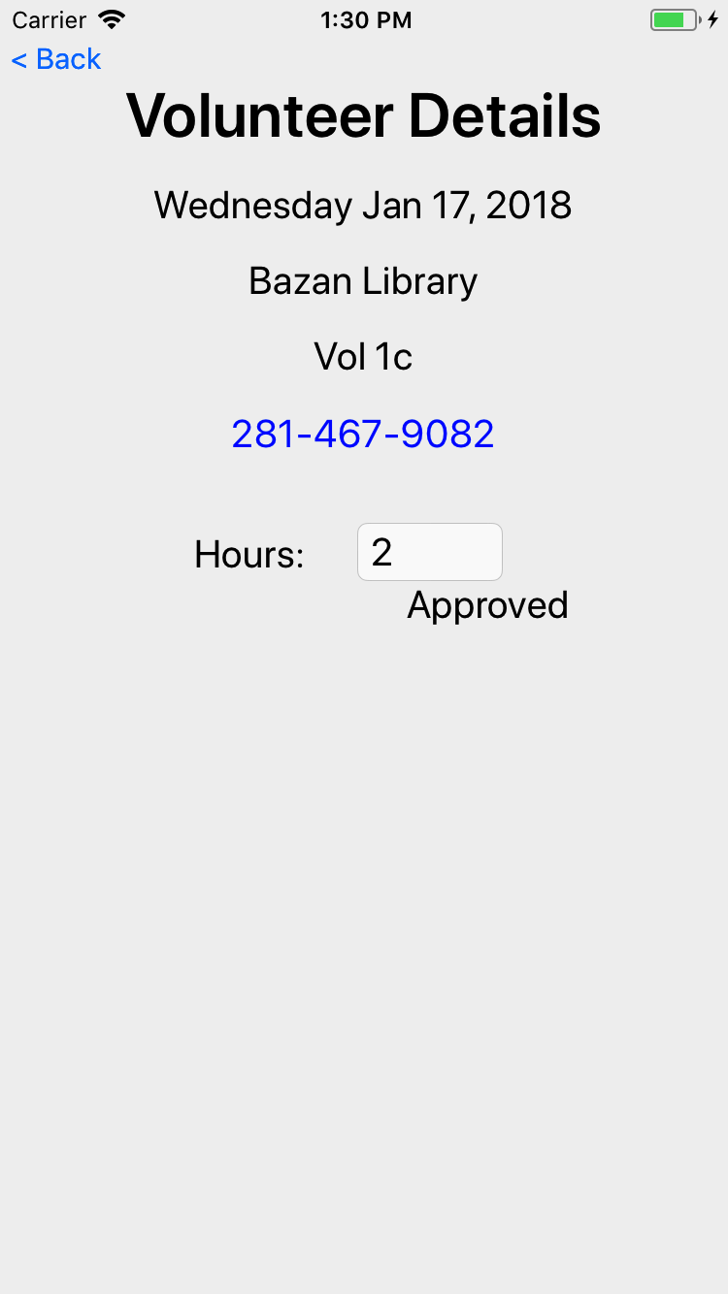
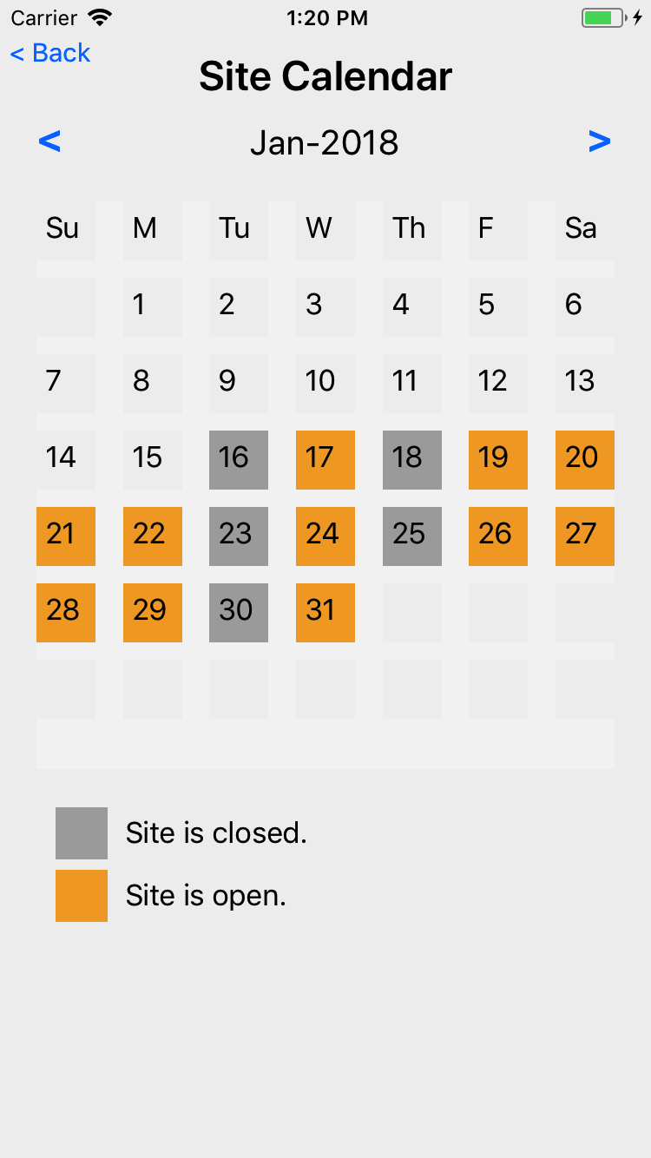
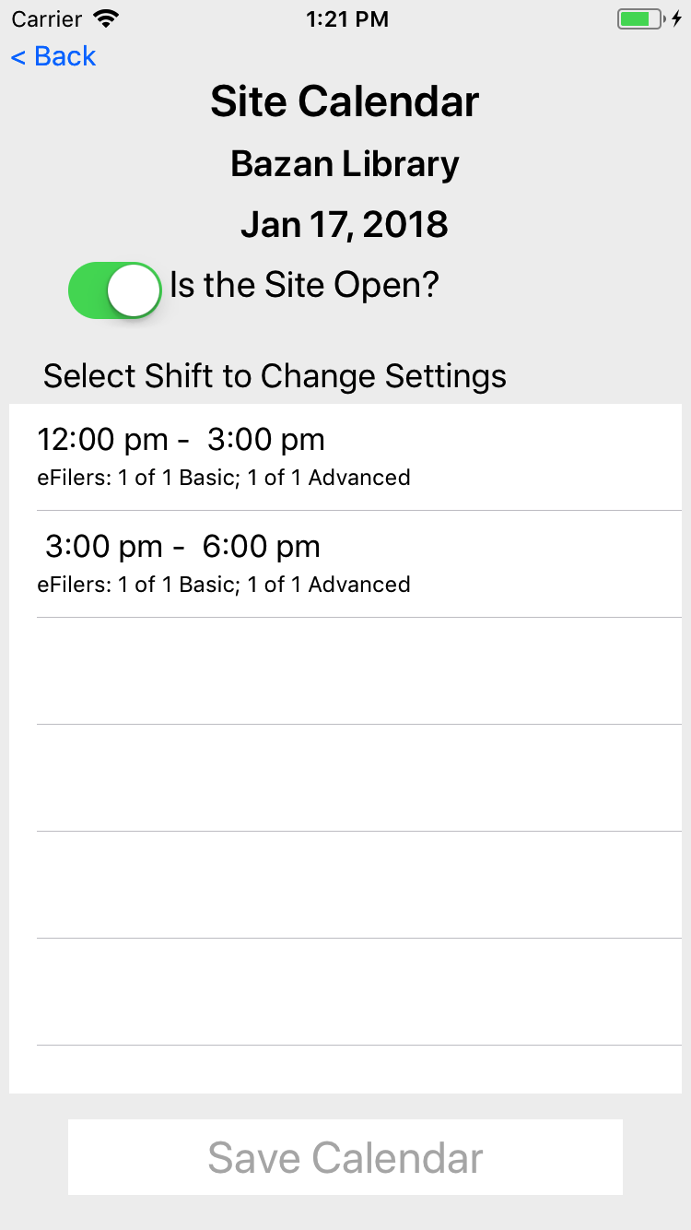
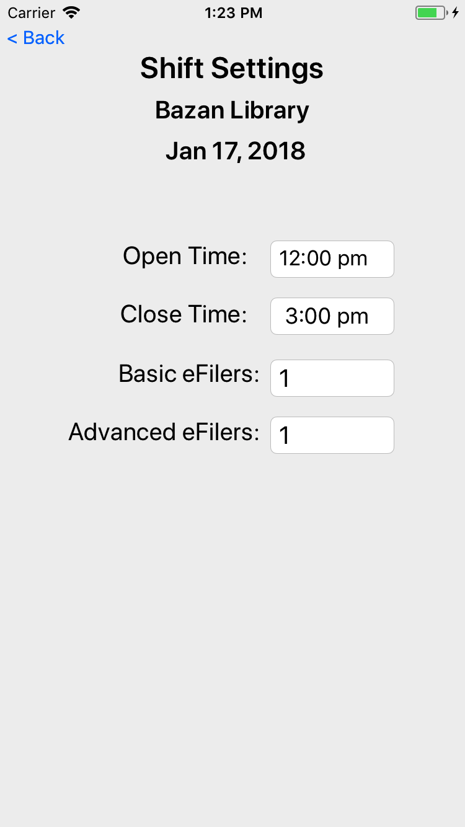
VITA App – Site Coordinators
Select Site
Manage
Dates
Shifts
Volunteers
Receive notifications from management office.
Site Calendar
Shifts
Shift Details

Slide 6
Site Coordinator Actions
Registration
Update site services
Update site calendar
Update number of eFilers on date
Approve eFiler hours

Slide 7
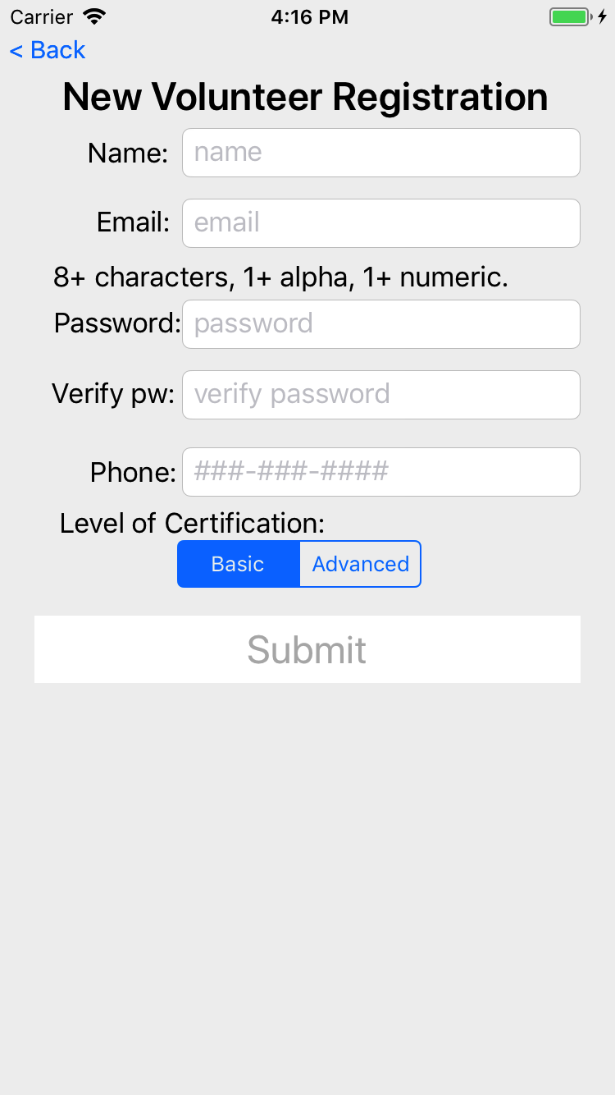
Registration
Everyone must register
Back office staff must review, approve, and assign a role (Volunteer)
Name, phone, and level of certification can be changed in Update Profile

Slide 8
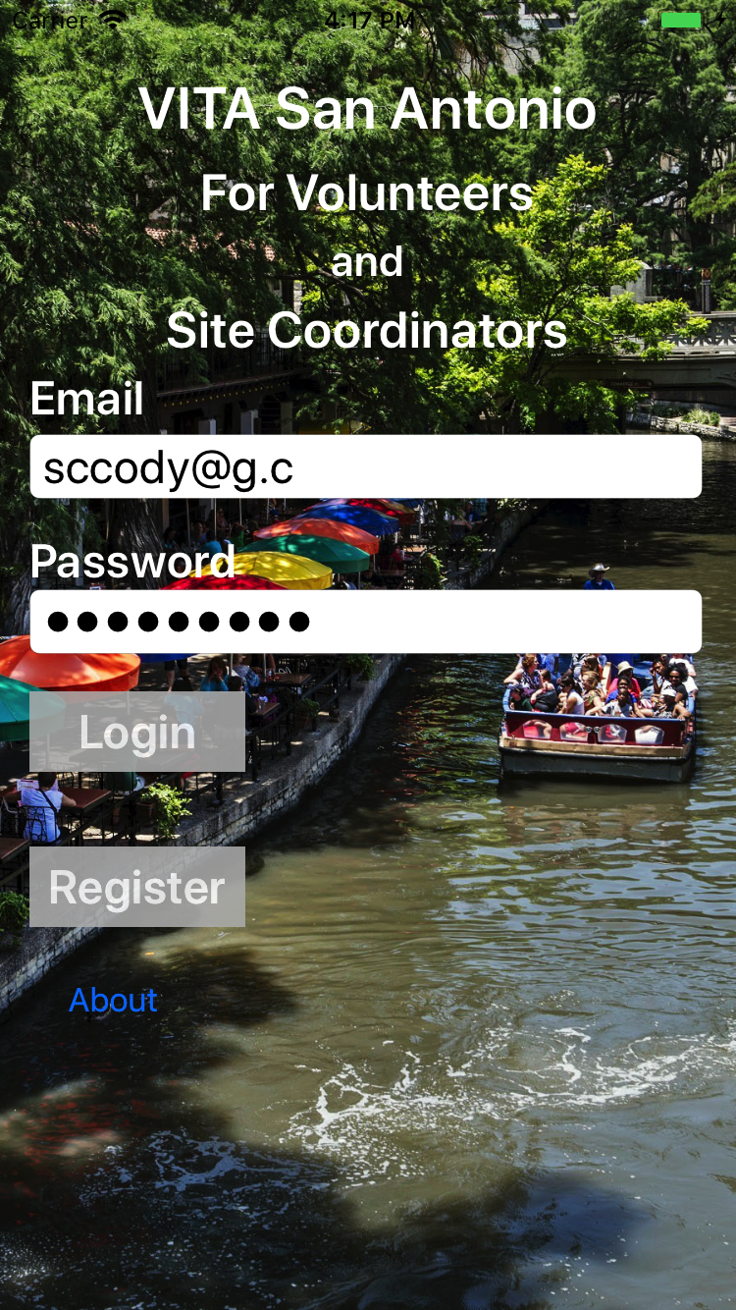
Update Site Features
Login with credentials from registration
For lost password, contact staff

Slide 9
Update Site Features
Select site to manage
If only managing 1 site, then this screen is not shown
Will be shown if you are primary on 1 site and backup on 1 or more sites

Slide 10
Update Site Features
Primary screen for managing a site
Adjust features as needed
Client status not used
Site features
Client Site Status (not used)

Slide 11
Update Site Calendar
Login with credentials from registration
For lost password, contact staff

Slide 12
Update Site Calendar
Select site to manage

Slide 13
Update Site Calendar
Primary screen for managing a site
Adjust features as needed
Client status not used

Slide 14
Update Site Calendar
Touch day of week to change site calendar
A calendar entry has shifts, which have open/close and number of basic/advanced efilers

Slide 15
Update Site Calendar
List of shifts for this site on this date
Save after making adjustments to open/close or shifts
The number of shifts can only be changed by the back office staff

Slide 16
Update Site Calendar
Set open/close time for this shift on this date and this site
Only one shift is affected
Set number of eFilers, either basic or advanced
Volunteers will no longer be able to volunteer for a shift when their cert level is full

Slide 17
View Volunteers
Login with credentials from registration
For lost password, contact staff

Slide 18
View Volunteers
Select site to manage

Slide 19
View Volunteers
Primary screen for managing a site
Adjust features as needed
Client status not used

Slide 20
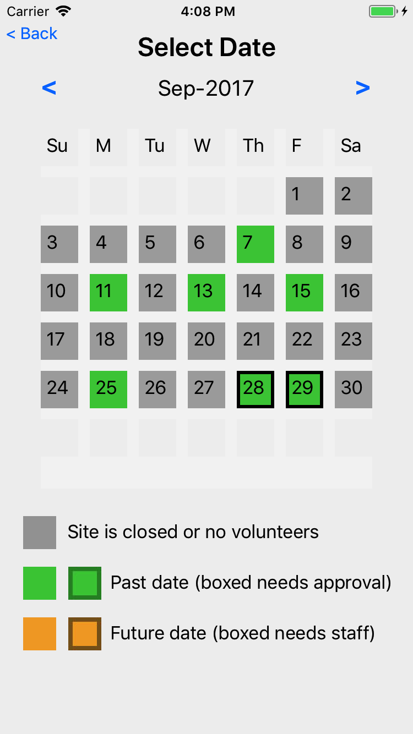
Summary view of volunteers at the site
Green are past dates, boxed for when 1 or more volunteers hours need approval.
Orange are future dates, boxed when the needed number of eFilers is less than the number signed up.

Slide 21
View Shifts
List of shifts
Quick summary of the number of volunteers for each shift currently signed up

Slide 22
View Volunteers
List of volunteers signed up to be at a site on a date
Phone and certification provided
Touch volunteer to view/change hours

Slide 23
View Volunteers
Adjust hours worked as needed
Volunteer can change hours until end of date
Touch phone number to call the volunteer

Slide 24
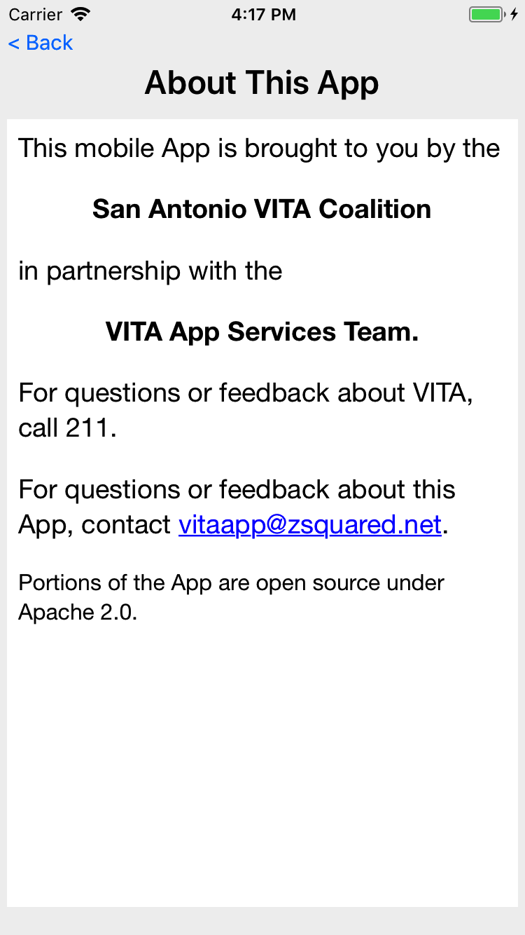
App About
Login not required
Contact the App support team using the email address on this page

Slide 25
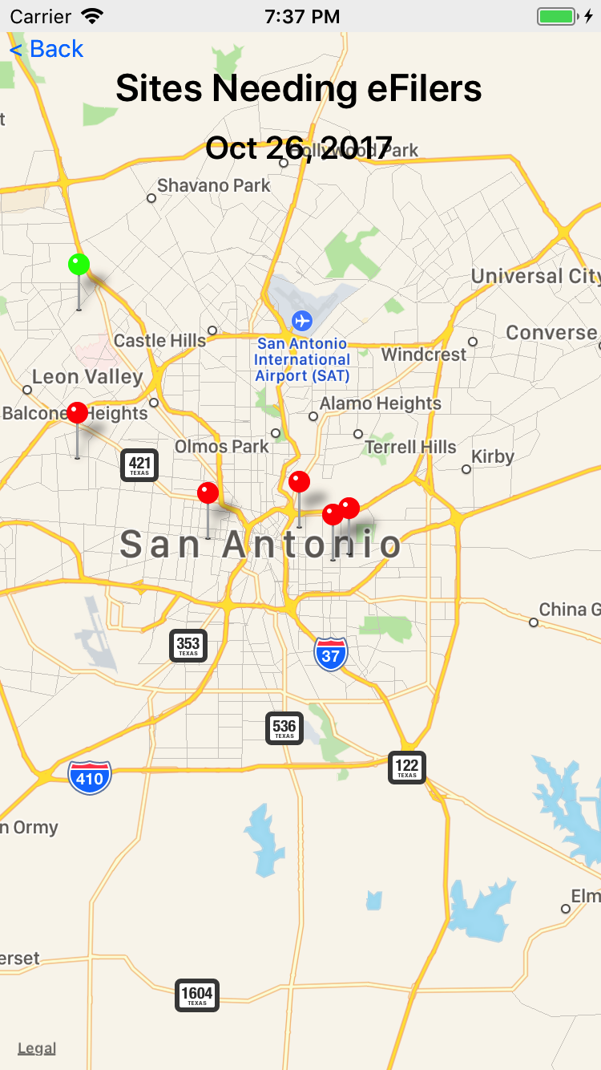
VITA SA App
Optimize the customer experience by fully utilizing staff, sites, and volunteers.
Encourage volunteers to go to the sites that need help.
(and away from sites that don’t)
Encourage clients to use the web and provide feedback.

